Slide 1

Google Play Apps Analysis- Technical Presentation
Date: 01-15-2021
Presenter: Xiangning Bu

Slide 2
Statistical analysis revealed the best factors and indicators that in relate to the popularity of apps
Overall analysis of the apps’ installation
and distribution
Which category has more apps in the store? Which one has the most installations? Are they the same?
Breakdown analysis of the apps store data
Which factors stand out in relate to popularity of apps, size, Price, rating, review?
Are those factors related to each other
Correlation analysis between installs, price, rating and review
Source: Kaggle Google Play Store Apps datasheet

Slide 3
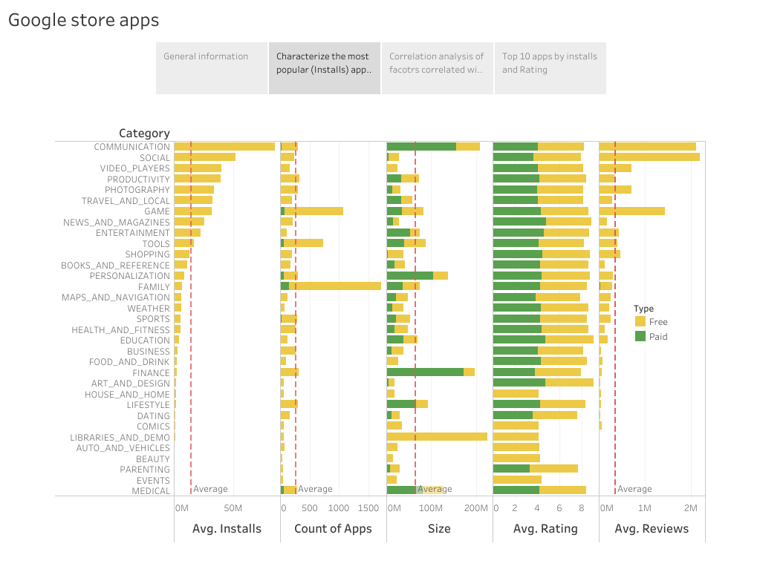
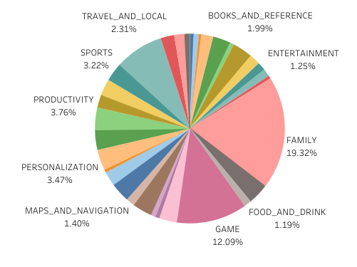
Overall summarization of the apps number and installs by category, reveals the inconsistent at between installation and app counts
Key insight:
Apps belong to family and game make up more than 30%of total apps.
Comparison of average installs showed that communication and social apps were more popular than game and family apps (red dot line is the average installs across all categories).
Source: Kaggle Google Play Store Apps datasheet

Slide 4
Breakdown analysis of the apps store data by individual factors
Key insight:
1.By category, apps with high average installs were also reviewed more.(red box)
2.Paid and free apps both have similar ratings around 4.(blue box)
3. Most of the free apps have an average size of less than 50M. (black box)

Slide 5
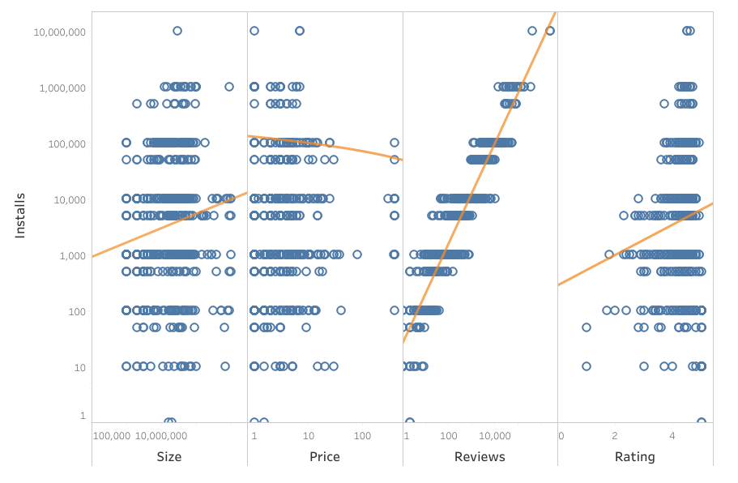
Correlation analysis between installs and other factors showed that size, rating and reviews are all positively correlated with installs, while price (paid apps only) is negatively related with installs.
Source: Kaggle Google Play Store Apps datasheet

